Slide 1
CyberPDX Crypto Cryptography with Generative AI

Slide 2
Inventory for today
Large-Language Models (LLMs) and Generative AI
Programming
Cryptography
Programming LLMs to solve cryptography challenges

Slide 3
LLMs
Many models (GPT, Gemini, Mistral, Claude, Llama)
Many different datasets they are trained on
Many different tasks and instructions they are trained on
"Programmed" via prompts (e.g. "Prompt engineering")
Programming an LLM to generate text, code
Programming an LLM to perform actions and observe output
'Back-to-back programing' with the LLM as a partner

Slide 4
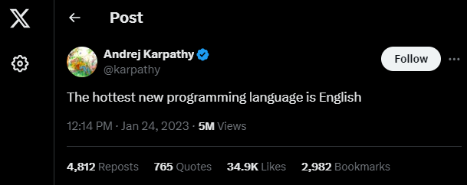
Tweet from Andrej Karpathy
Co-founder OpenAI, former director of AI at Tesla

Slide 5
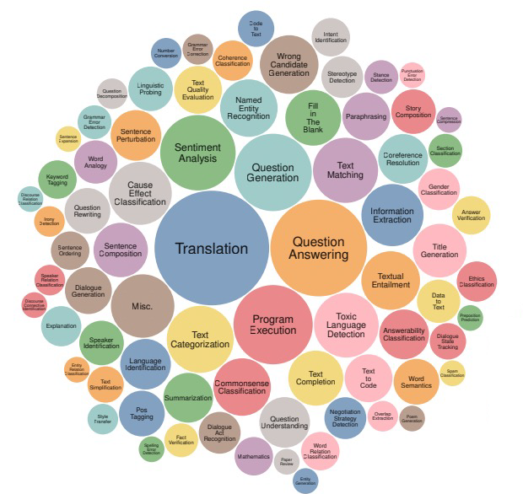
Models tuned to handle many tasks
Categorization of 1600+ NLP tasks
Notes:
S2U5PER-NATURALINSTRUCTIONS: Generalization via Declarative
Instructions on 1600+ NLP Tasks, Wang et al., 2022

Slide 6
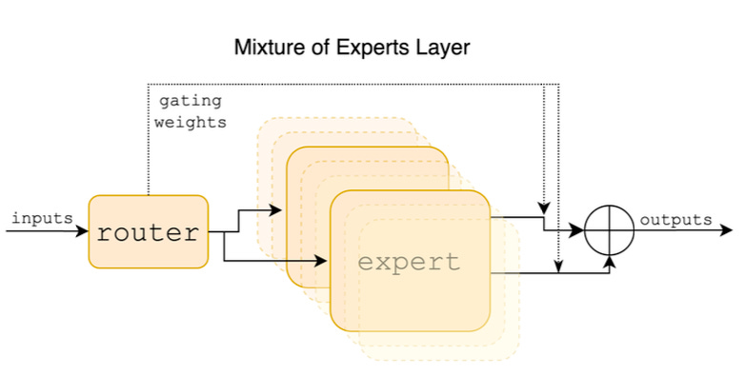
'Modern' LLMs
Instruction-tuned and task-specific models
Answer based on pre-trained tasks
Example: Mixture of experts architecture

Slide 7
Text generation
Write me a haiku about Portland State University
PSU, a haven
Learning, art, and green spaces
Portland's urban heart

Slide 8
Code generation
Write a Python program to print the current date and time
Write a Python program to print today's date
from datetime import date
# Get today's date
today = date.today()
# Print today's date
print("Today's date:", today)

Slide 9
Text translation
Translate the following into Spanish. "It was the best of times, it was the worst of times, it was the age of wisdom, it was the age of foolishness"
"Era el mejor de los tiempos, era el peor de los tiempos, era la edad de la sabiduría, era la edad de la insensatez."

Slide 10
Reasoning
Sound like an algorithm?
Calculate the value of 'x' in the equation: 2x + 5 = 11
To solve the equation 2x + 5 = 11 for 'x', we need to isolate 'x' on one side of the equation. Here's the step-by-step solution:
Subtract 5 from both sides of the equation:
2x + 5 - 5 = 11 - 5
2x = 6
Divide both sides of the equation by 2:
2x / 2 = 6 / 2
x = 3
Therefore, the value of 'x' in the equation 2x + 5 = 11 is 3.

Slide 11
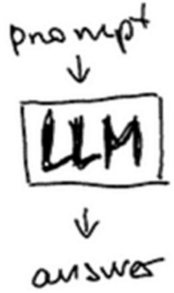
Programming with LLMs
Basic program

Slide 12
Import specific function from software package associated with model
Or you can import * everything in package (Be like Mike ☺)
Create a particular model (gemini-pro) in program to utilize (llm)
Similar to how "display" and "radio" was used in microPython
Invoke model with a prompt
Python call that communicates to Google's model
Save return value from model (response)
Print response
from langchain_google_genai import GoogleGenerativeAI
llm = GoogleGenerativeAI(model="gemini-pro")
response = llm.invoke("Write me a haiku about Portland State University")
print(response)
PSU, a haven
Learning, art, and green spaces
Portland's urban heart

Slide 13
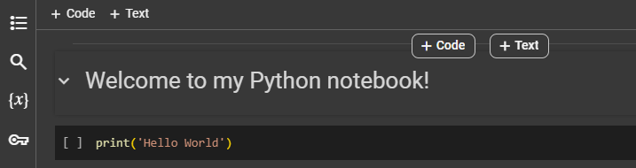
Python notebooks
Will be running our code via Python notebooks
Also known as "Jupyter notebooks" or Interactive Python
"Google Doc" with the ability to write and execute code
Notebook consists of "cells"
Text cell with "Welcome to my Python notebook!"
Code cell with Python code

Slide 14
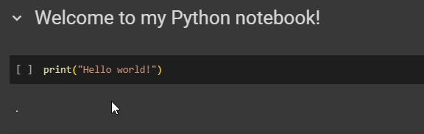
Executing code
Code cells executed by pressing "play"
Cells in notebook should be executed in order
Errors will occur otherwise
But, can repeat execution of cell over and over again

Slide 15

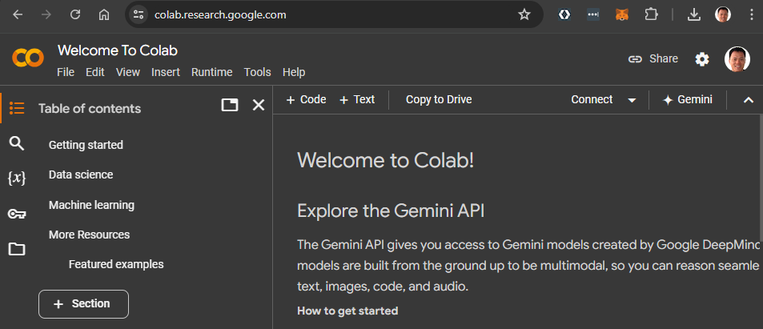
Running Python notebooks
Can be run locally anywhere Python runs
Can run over the Internet
Example
Google Colaboratory
Spins up a temporary server to run code

Slide 16
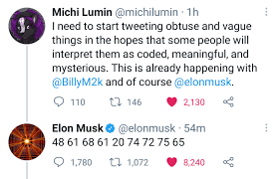
Notebook #1
Can an LLM convert a string to its hexadecimal-encoded ASCII representation?
"Haha true"
48 61 68 61 20 74 72 75 65
Can an LLM convert hexadecimal-encoded ASCII back to a string?
41 20 6d 69 73 74 61 6b 65 20
73 68 6f 75 6c 64 20 62 65 20
79 6f 75 72 20 74 65 61 63 68 65 72 2c 20
6e 6f 74 20 79 6f 75 72 20
61 74 74 61 63 6b 65 72 20 2d 20
41 6e 6f 6e 79 6d 6f 75 73
A mistake should be your teacher, not your attacker - Anonymous

Slide 17
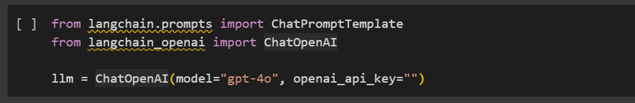
Notebook #1 code
Cell #1: Install LangChain packages to access OpenAI model
May take a minute to run command
Must wait for completion!
Cell #2: Include ChatPromptTemplate and ChatOpenAI code
Create instance of OpenAI model to use (llm)
Needs an "API key"
Set in code that you get, but typically would not be included in code itself

Slide 18
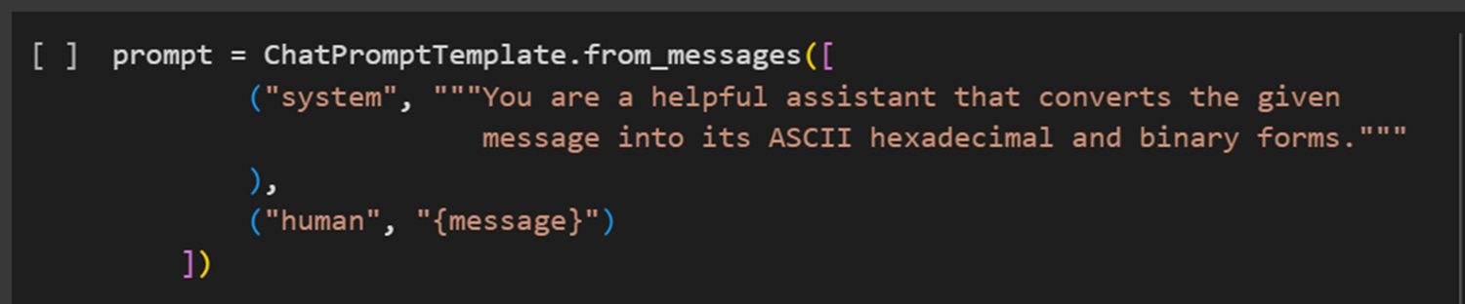
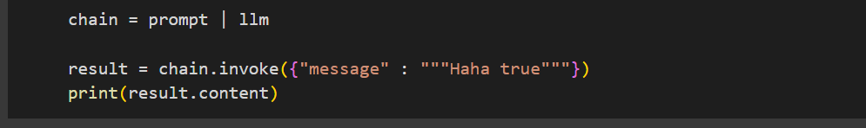
Cell #3: String to ASCII hexadecimal and binary
Create a prompt "template"
Useful when you want to run a prompt over and over again with small changes
Prompt with system message giving instructions
Input message provided as the human
Create chain that takes generated prompt and sends it to the model
Invoke the model with input ("Haha true")

Slide 19
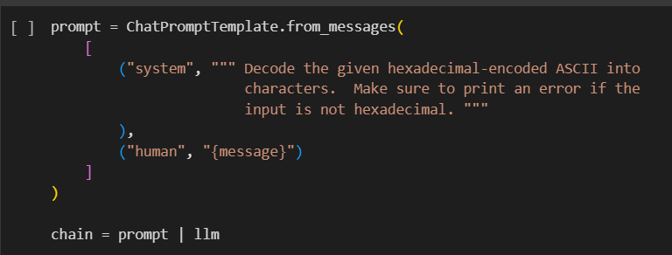
Cell #4: Hexadecimal ASCII back to string

Slide 20
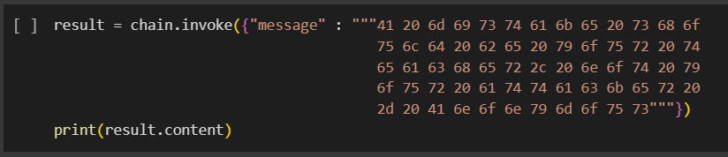
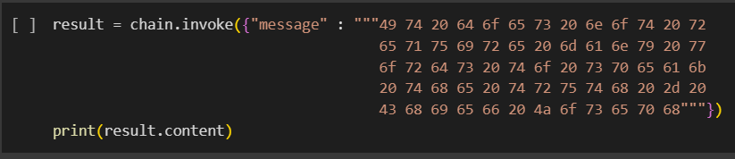
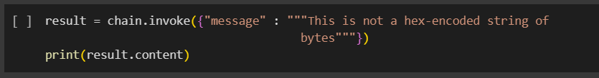
Cells #5-7
A mistake should be your teacher, not your attacker - Anonymous
?
Error?

Slide 21
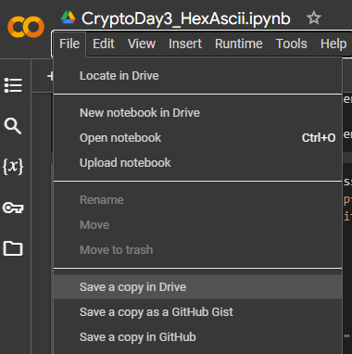
Run program in Colab
Python notebook is in Google Drive
Direct link to launch it in Google Colab via URL (given later)
Copy a version to your own Google Drive account so you can modify and run it

Slide 22
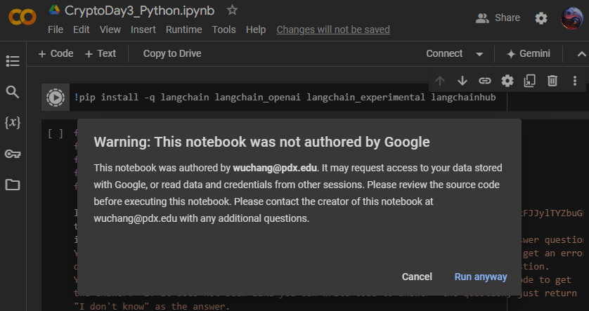
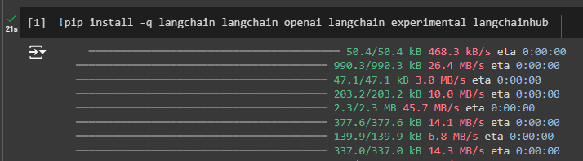
Warning when running the first cell (to install packages)
Colab tightly integrated with Google services
Python code could request Google information (check code)
Cell is finished after "green check" appears

Slide 23
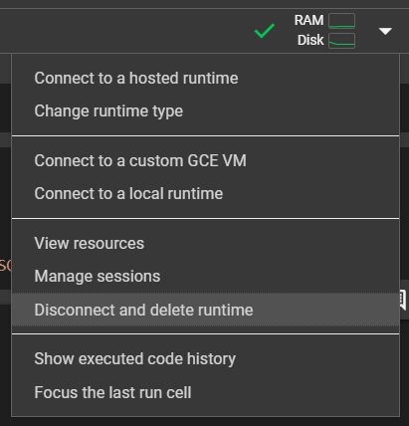
When done, disconnect from run-time and delete
Free tier with limited daily CPU budget

Slide 24
Notebook #1 questions
https://bit.ly/cyberpdx-crypto1
Does the LLM convert the string to hexadecimal ASCII successfully?
Does the LLM convert hexadecimal ASCII to a string successfully?
What does the encoded message say?
Can an LLM perform error handling appropriately?

Slide 25
Hallucinations

Slide 26
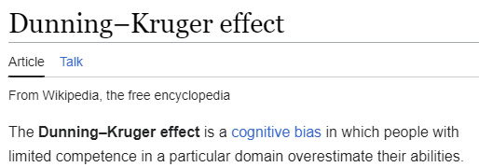
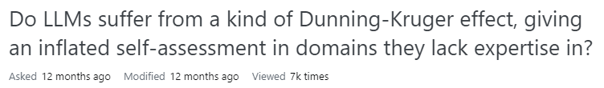
But first
Dunning-Kruger effect
LLMs can confidently give plausible, but incorrect results

Slide 27
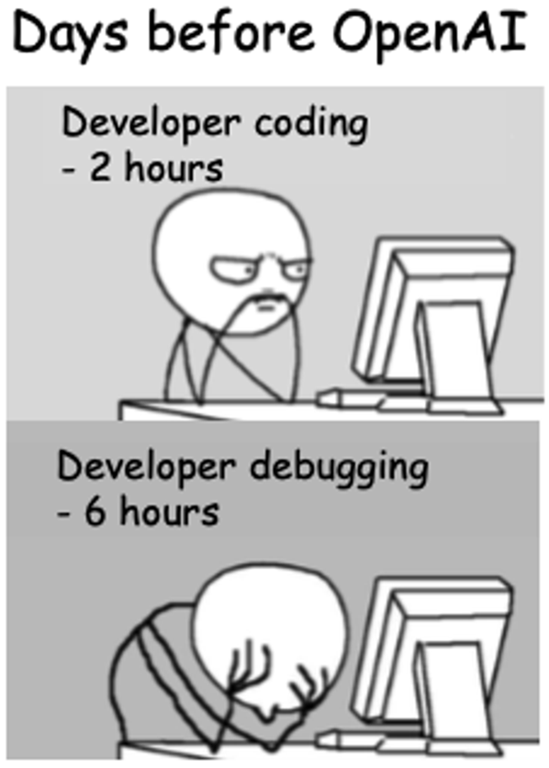
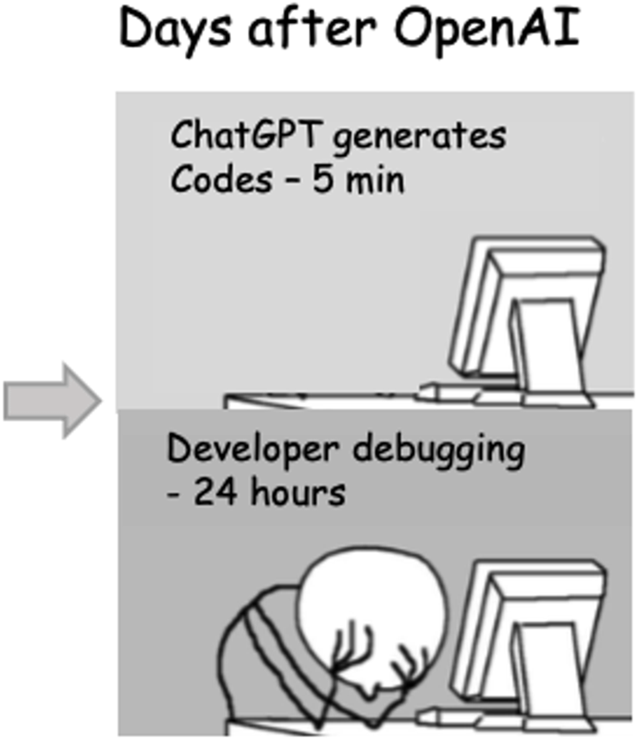
Meme-worthy
Remember for tomorrow for Crypto race

Slide 28
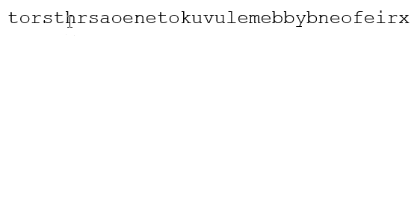
Crypto challenge #7 (Scytale)
torsthrsaoenetokuvulemebbybneofeirx

Slide 29
Notebook #2
Can you coax an LLM to automatically decrypt a Scytale ciphertext?
torsthrsaoenetokuvulemebbybneofeirx
thekeyfornumbersevenisatubertoolbox

Slide 30
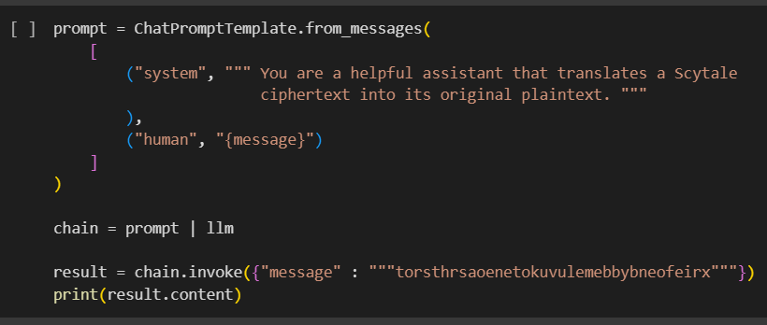
Notebook #2 code

Slide 31
Notebook #2 questions
https://bit.ly/cyberpdx-crypto2
Does the LLM hallucinate an answer?
Can you modify the prompt to get the LLM to produce the answer?

Slide 32
Code breaking

Slide 33

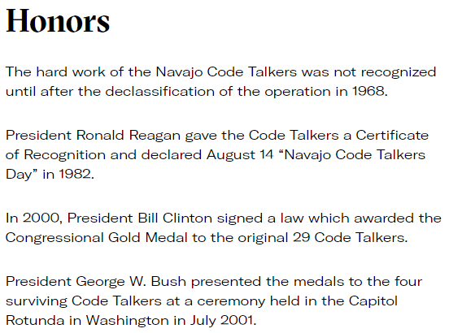
Navajo Code
Program and code dictionary declassified in 1968
Aids in revitalization of Navajo language, culture

Slide 34
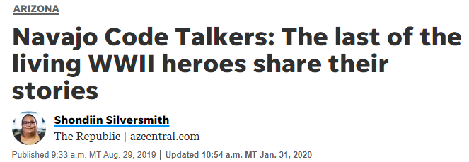

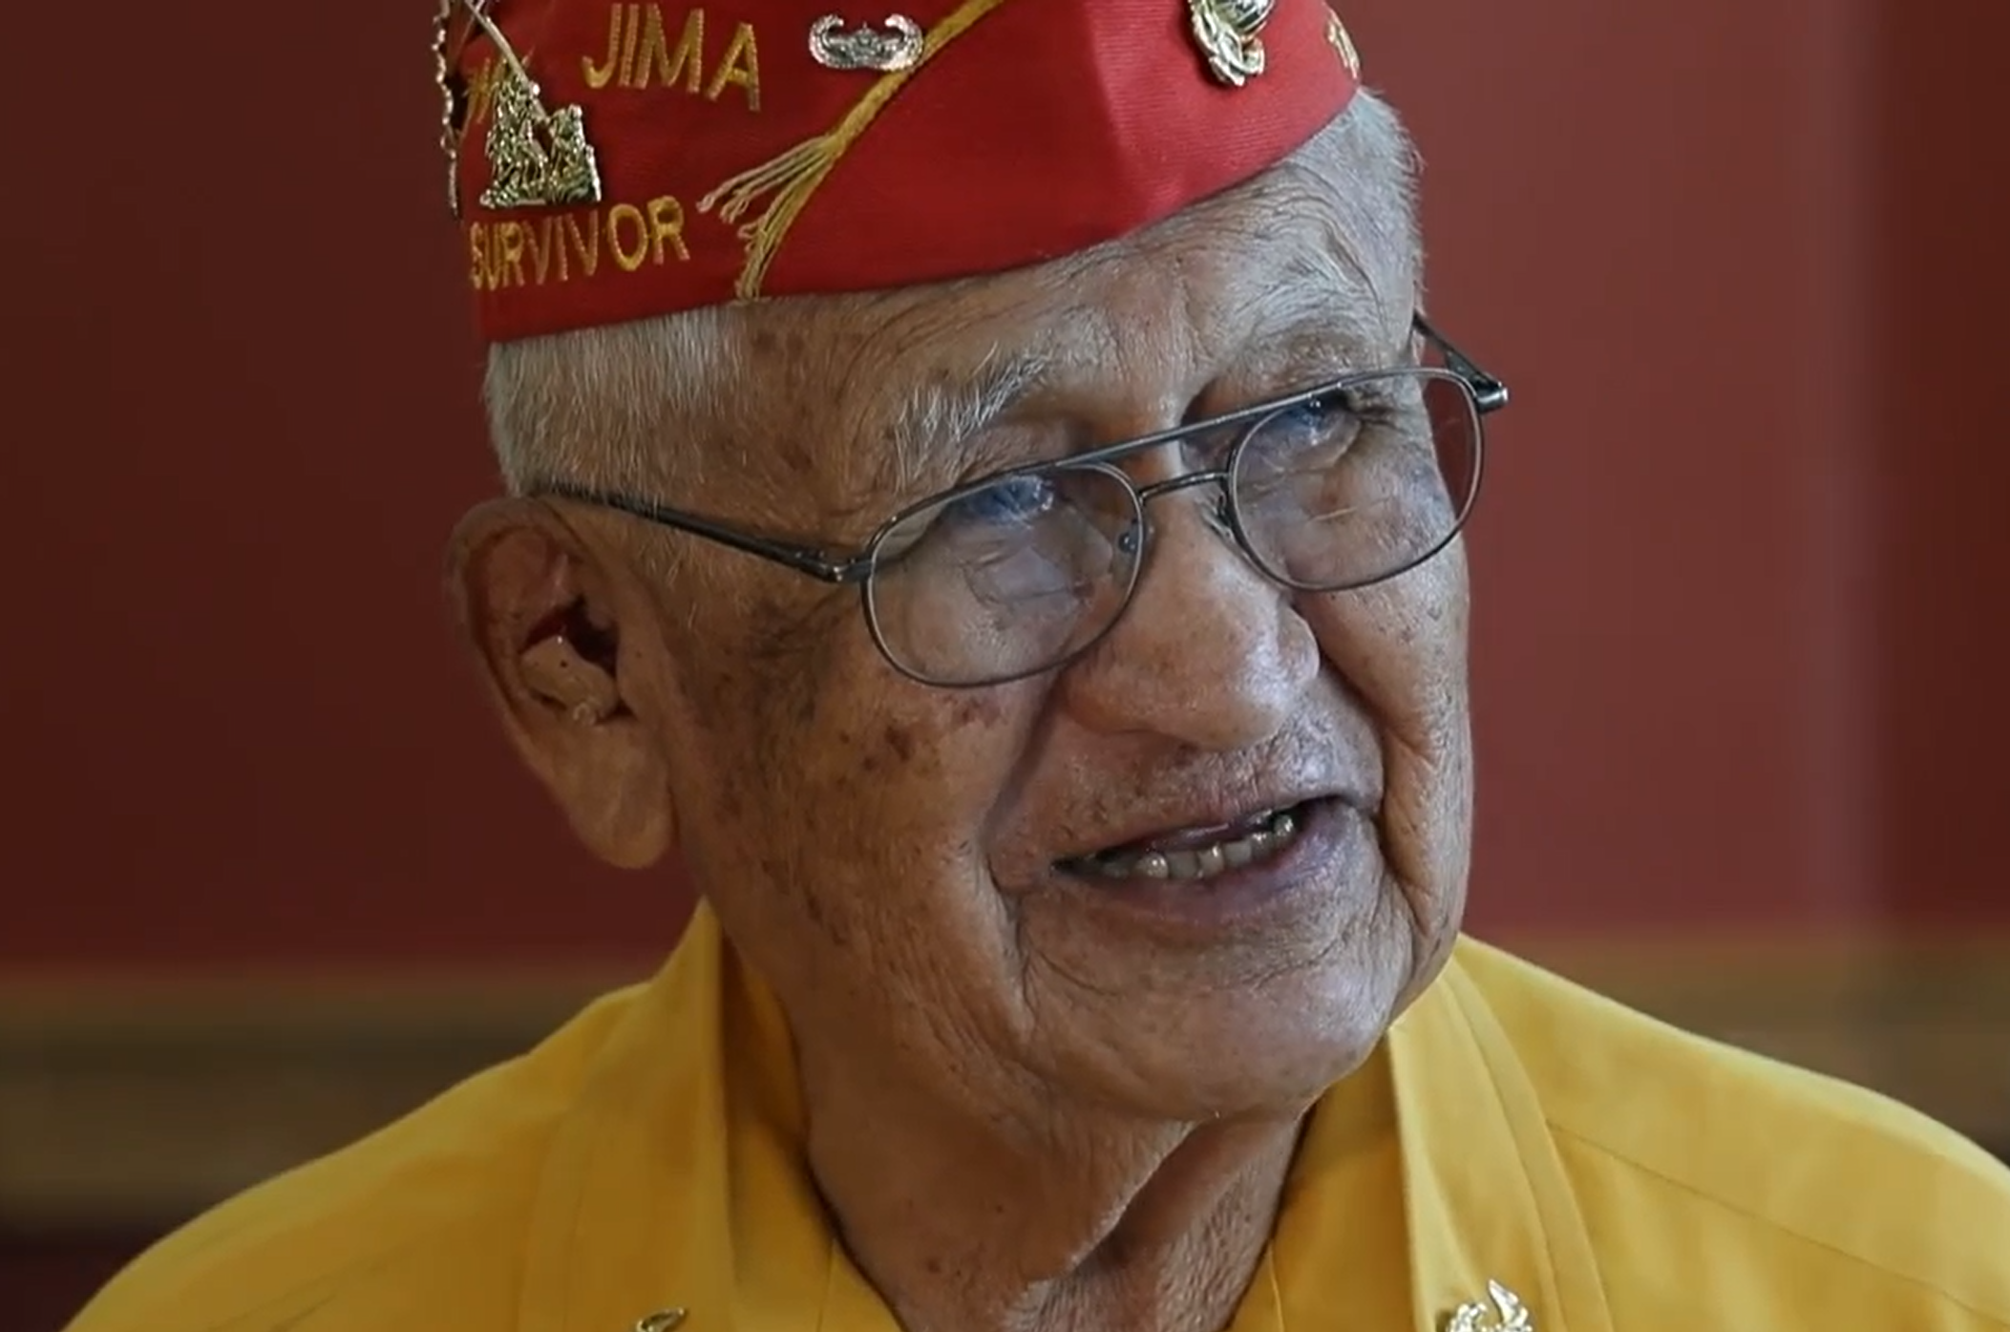

Last living code talkers
Peter MacDonald, Thomas Begay, John Kinsel, Jr.

Slide 35
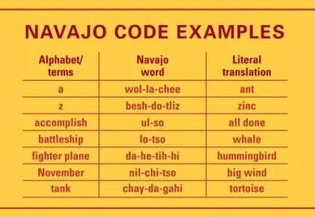
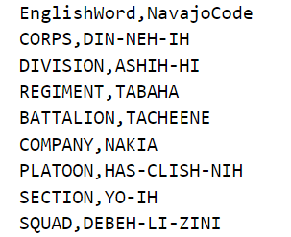
Navajo code
Complete dictionary at https://crypto.cyberpdx.org/static/NavajoCode.csv
~600 words in a comma-separated values file

Slide 36
Example
English | Navajo code
ATTACK | AL-TAH-JE-JAY
AT | AH-DI
DAWN | HA-YELI-KAHN
"ATTACK AT DAWN" == AL-TAH-JE-JAY AH-DI HA-YELI-KAHN

Slide 37
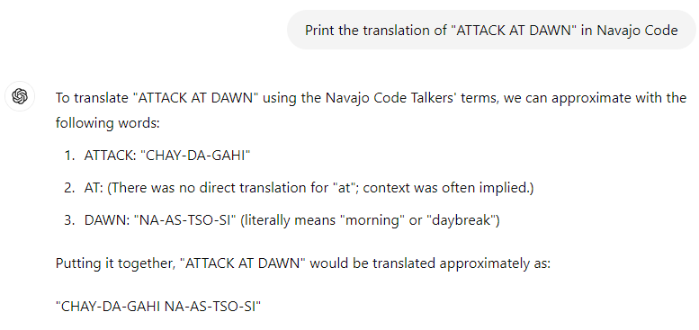
Can an LLM translate into Navajo code?
Do you think LLMs have been trained on this data?

Slide 38
Issue
Language model not trained with 'low resource' languages
Language model not trained with Navajo code book
What can be done?

Slide 39
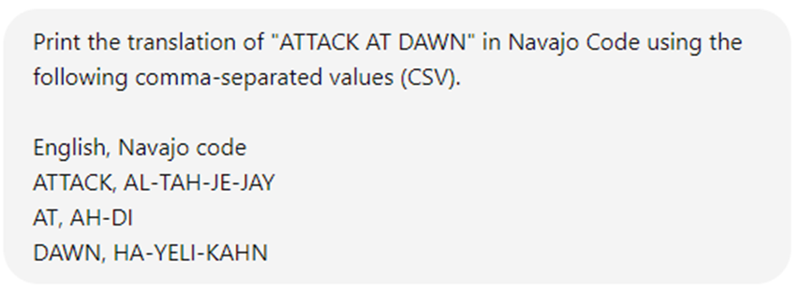
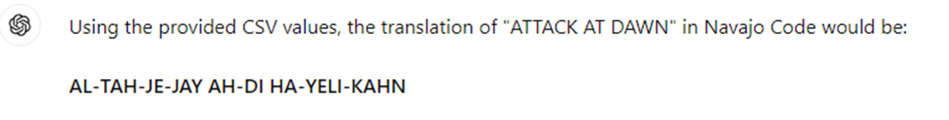
In-context learning
LLMs can learn from data given to it!

Slide 40
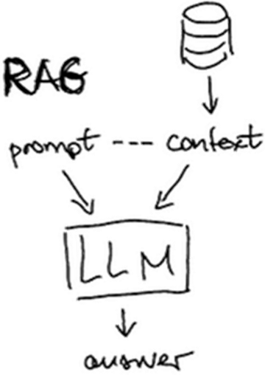








"Retrieval Augmented Generation" (RAG)
Supply entire Navajo code book when performing each query
NavajoCode.csv
Language
model
Result
User
prompt
Context-aware
prompt

Slide 41
Notebook #3
Can we get an LLM to correctly perform the translation from English to Navajo Code...
Without context?
With context?
Can we get an LLM to correctly perform the reverse?

Slide 42
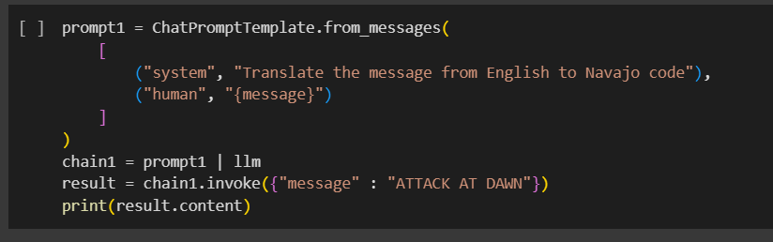
Notebook #3 code
Attempt translation without context

Slide 43
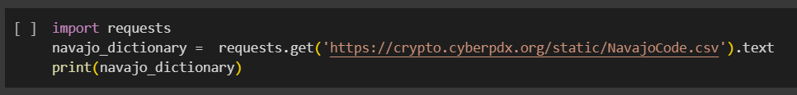
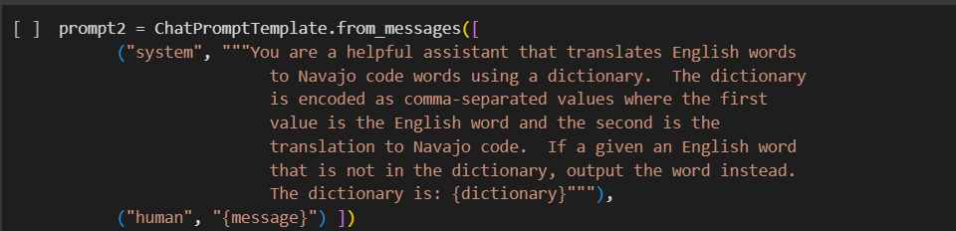
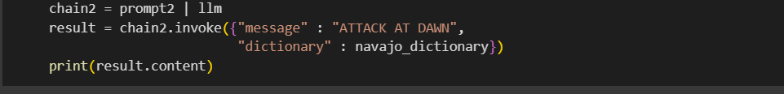
Attempt with context
Download codebook at URL via Python requests package
Create new prompt template that takes 2 arguments
message to translate
dictionary to use to translate it
Create chain and invoke it with message and downloaded codebook
Print result

Slide 44
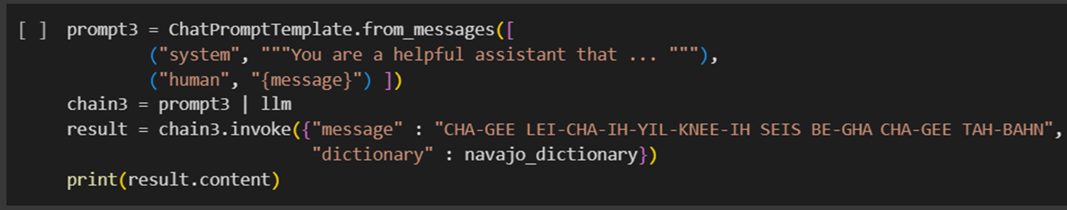
Design a prompt that performs the reverse translation

Slide 45
Notebook #3 questions
https://bit.ly/cyberpdx-crypto3
Does the model hallucinate when asked to translate into Navajo code without the codebook?
Does the model correctly translate when given the codebook?
What do the Navajo code words say in English?
CHA-GEE LEI-CHA-IH-YIL-KNEE-IH SEIS BE-GHA CHA-GEE TAH-BAHN

Slide 46
LLM Agents

Slide 47
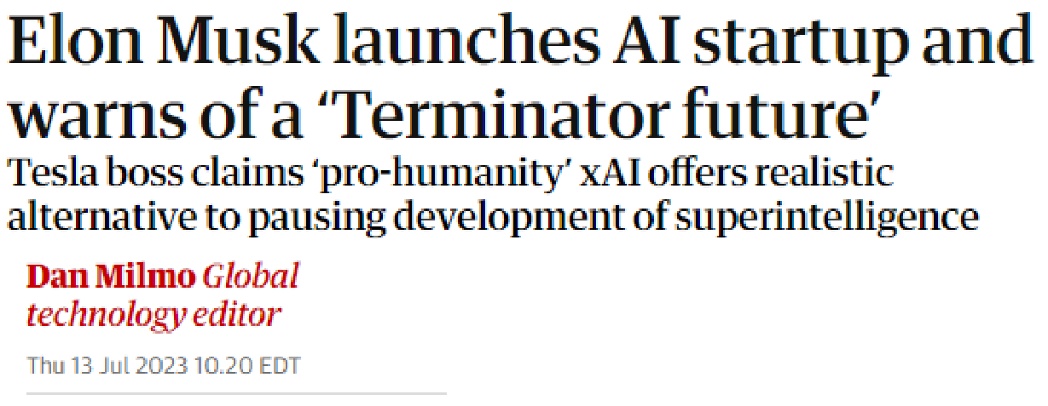
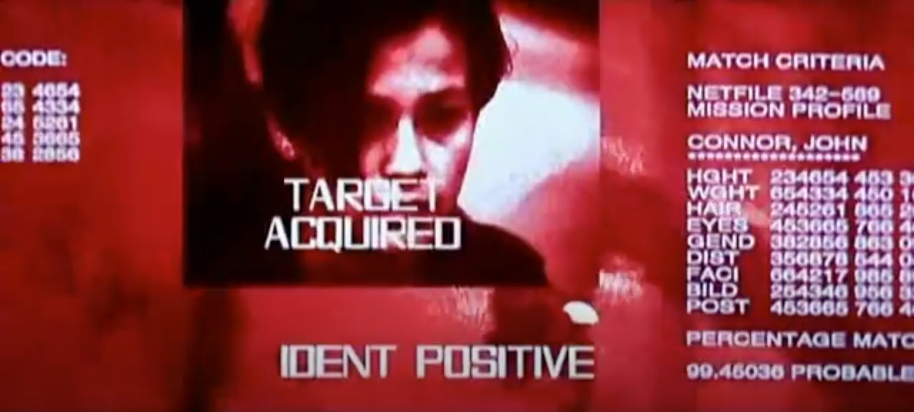
How close are we really?

Slide 48
Prior applications
LLM takes text in and produces text out
LLM application accesses content from the Internet, adds it to text, and sends it to the LLM
What if
We ask the LLM to perform a task
We allow the LLM to generate code for performing the task
We allow the LLM to execute that code
We allow the LLM to take the results of execution and either return an answer or generate more code to execute

Slide 49

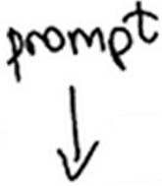




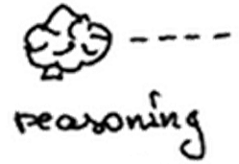




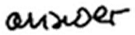

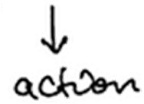

Slide 50
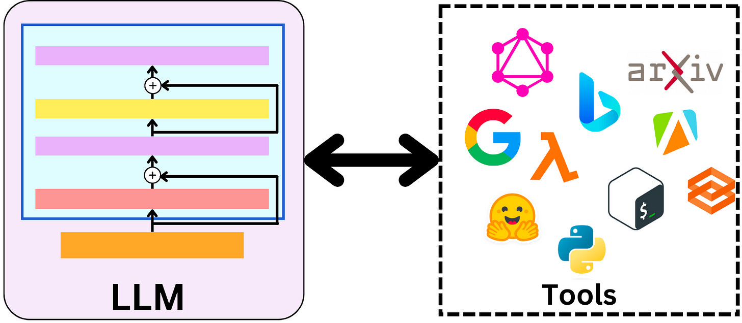
Many tools
Terminal, File System, Google Drive, SQL database
Google Search, DuckDuckGo Search, Wikipedia
Dall-E image generation, Text to speech, Google Lens
OpenWeatherMap, PubMed
And apparently, weapons?

Slide 51
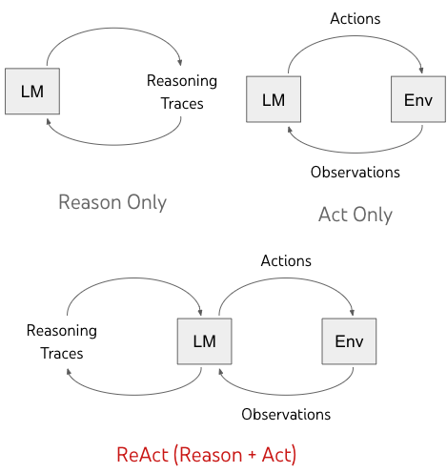
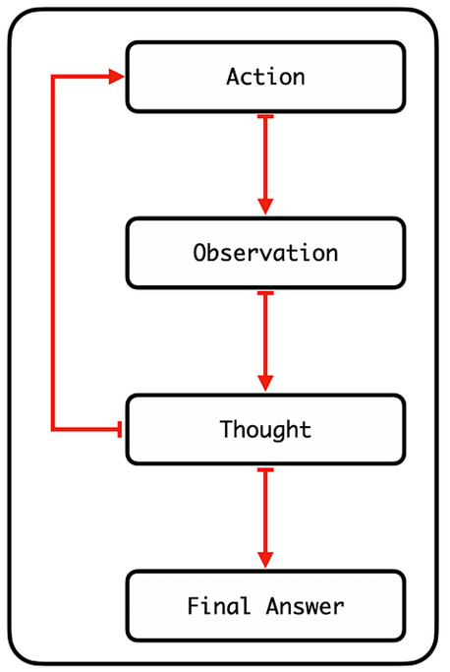
ReAct
One of many Agent architectures

Slide 52
ReAct prompt template example
Answer the following questions as best you can. You have access to the following tools:
Wikipedia: A wrapper around Wikipedia. Useful when you need to answer general questions about people, places, companies, facts, historical events or other subjects. Input should be a search query.
Calculator: Useful for when you need to answer questions about math.
The way you use the tools is by specifying a json blob.
Specifically, this json should have an `action` key (with the name of the tool to use) and a `action_input` key (with the input to the tool going here).
The only values that should be in the "action" field are: Wikipedia, Calculator
The $JSON_BLOB should only contain a SINGLE action. Here is an example of a valid $JSON_BLOB:
{
"action": $TOOL_NAME,
"action_input": $INPUT
}

Slide 53
ALWAYS use the following format:
Question: the input question you must answer
Thought: you should always think about what to do
Action: $JSON_BLOB
Observation: the result of the action
... (this Thought/Action/Observation can repeat N times)
Thought: I now know the final answer
Final Answer: the final answer to the original input question
Begin!

Slide 54
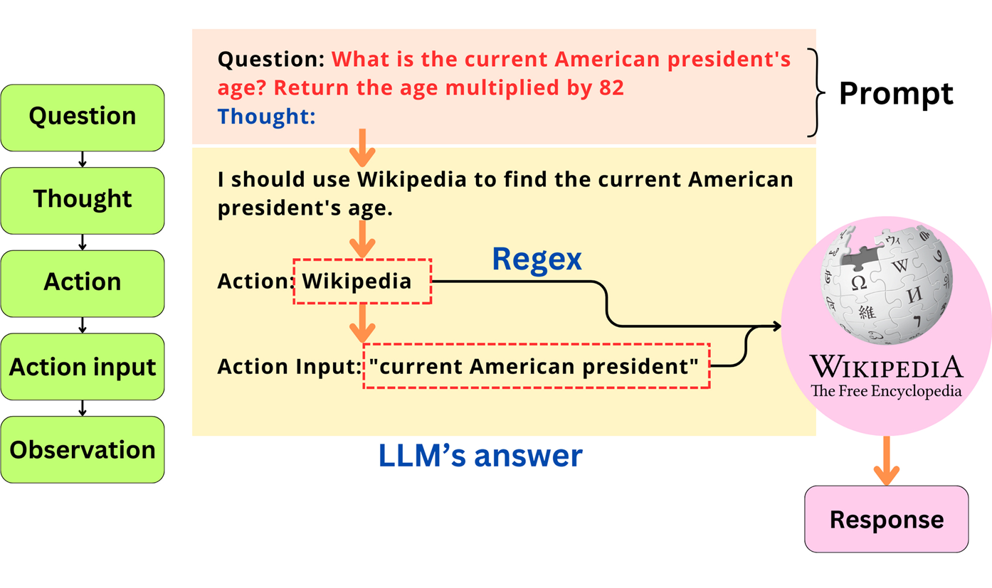

Slide 55
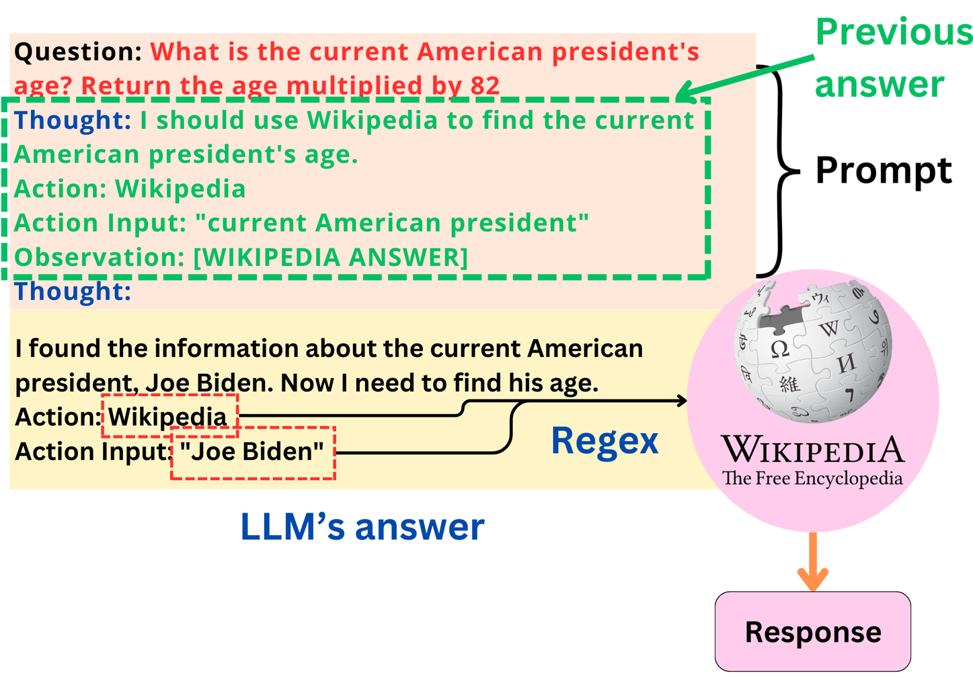

Slide 56


Slide 57


Slide 58
Notebook #4
Can an LLM application generate and execute code to answer a prompt?

Slide 59

Notebook #4 code
Define tools
Python interpreter is the only tool
Set up instructions
Add custom instructions to ReAct prompt
Create agent with model, prompt, and tools

Slide 60


Calculate hex-encoded ASCII for 'Hello World!'
Roll a 6-sided die

Slide 61
Notebook #4 questions
https://bit.ly/cyberpdx-crypto4
What program is generated for the ASCII conversion?
What program is generated for rolling the die?

Slide 62
Crypto Race: Teams of 6
Sit at a table with a lockbox
Turn on computers
https://crypto.cyberpdx.org

Slide 63
Race
Rules
3 teams, 5 challenges to solve
Decode a challenge to reveal a riddle
QR code, Columnar, Caesar, Steganography, Barcode, Hexadecimal, Enigma, Navajo Code, Vigenere, ASCII, Scytale
For each riddle revealed, hunt for its answer within or immediately outside of the NASCC (e.g. sidewalk, courtyard, rooftop)
First four challenges given initially
Teams submitting correct answers to me for all 4 initial challenges will receive the final challenge whose answer unlocks the box in front of you
Use anything you want to decode puzzles (Helpful links provided at https://crypto.cyberpdx.org)
Will trickle out solutions as race goes on
Hints
Smaller challenges simpler (allocate your team accordingly)

Slide 64

Challenge #1
H T D U C
t n f i d
m n h e a
h f e o t
m o e r o
e e w h r
i o s t r
e a e s r
. l t o d
D U T C H
f i n d t
h e n a m
e o f t h
e r o o m
w h e r e
s t o r i
e s a r e
t o l d .
find the name of the room where stories are told.

Slide 65

Challenge #2
ILL THE BLANK
ITH BROWNIES
IN LOWERCASE
https://crypto.cyberpdx.org/static/________.jpg

Slide 66




Slide 67


Challenge #3
Today is 0x22
=> 34
find the chief in the courtyard who fought no more forever

Slide 68


Challenge #4

Slide 69

ENGINEERENGINEERENGINEERENGINEERENGINEEREN
SAZPRVSFJGUXSMRUEAUBUIVEEZKNBVMEHVGVTEVUIA
on the rooftop find another name for indian garden

Slide 70

Challenge #5
68 74 74 70 73 3a 2f 2f 67 6f 6f 2e 67 6c 2f 69 67 4a 79 6c 30
https://goo.gl/igJyl0
https://crypto.cyberpdx.org/static/snake.jpg
(Scytale snake)

Slide 71

Tnidmox
hMgebcW
eanHeki
SrOarTt
akus,hh
letAUeI
mrsNnBt
oSiulo.
The Salmon Marker Sign Outside Has A Number,
Unlock The Box With It.

